Slide 1
Statistics Department Orientation
Computing Lab
8/21/2024

Slide 2
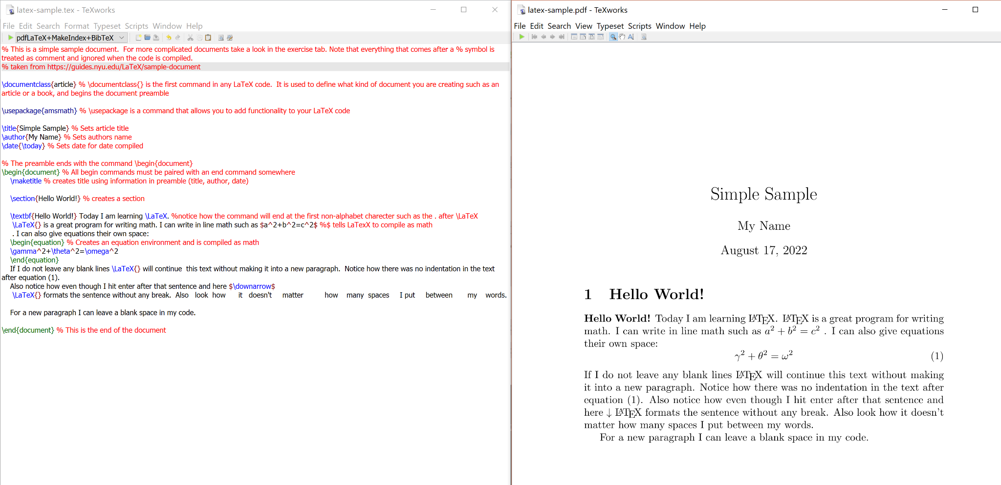
Latex
Software you will use for many of your homework assignments and for academic writing to have more standardized text, equations, figures, tables, and more.

Slide 3
Latex
Different compiling tools:
Overleaf (overleaf.com)
Pros: user friendly, good for collaboration, auto-save
Cons: compilation issues
Tex Editor: https://beebom.com/best-latex-editors/
Pros: better for research / publications
Cons: no auto-fill
Command line / terminal

Slide 4
RStudio / RMarkdown
Download R / RStudio:
Base R: https://www.r-project.org/
RStudio: https://www.rstudio.com/products/rstudio/download/#download
Install RMarkdown
install.packages("rmarkdown")
install.packages("knitr")
RMarkdown recommended when you have both computations, plots, and mathematical symbols and equations
Syntax in main text is the same as Latex!

Slide 5
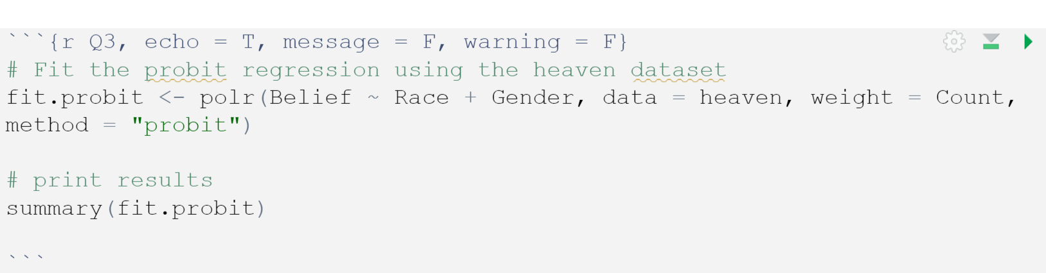
Rmd Chunks
Chunk options
include = FALSE : prevents code and results from being printed in output
echo = FALSE : prevents only the code from being printed in output
message = FALSE : prevents the messages from running the code to be shown
warning = FALSE : prevents any warnings from running the code to be shown

Slide 6

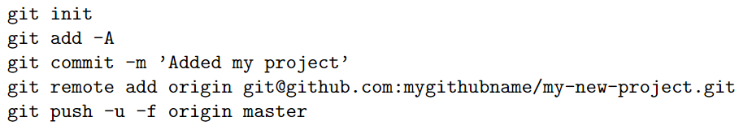
Using Linux for Github
Github is useful for saving and sharing your code
Many ways to integrate RStudio and Github
Git Bash: https://git-scm.com/downloads
To clone a repository already on your Github account:
To push updated code to your repository:

Slide 7
Linux
Good to be familiar with basic commands
In grad school, most likely will need to be familiar with Linux when
Connecting to a server (to run large computations)
Sending files securely (strict permissions)
Using C++ instead of R
Using Git with RStudio (Git Bash)

Slide 8
Linux
Basic commands:
cd - change directory
ls - list files in current directory
vim - enter file editor
touch - create new file
touch newFile.R
cp - copy file
cp originalFile.R newFile.R
Other useful commands can be found at this link:
https://cheatography.com/davechild/cheat-sheets/linux-command-line/

